Slide 1
Welcome to Year 1

Slide 2
Conifer Class
Mr. Young
Miss. Sudlow
Miss. Callaway
SENDco
Mrs Clark
Additional Support
Mr Miles
Sports Coach
66Coaching
Lunchtime Supervisor

Slide 3

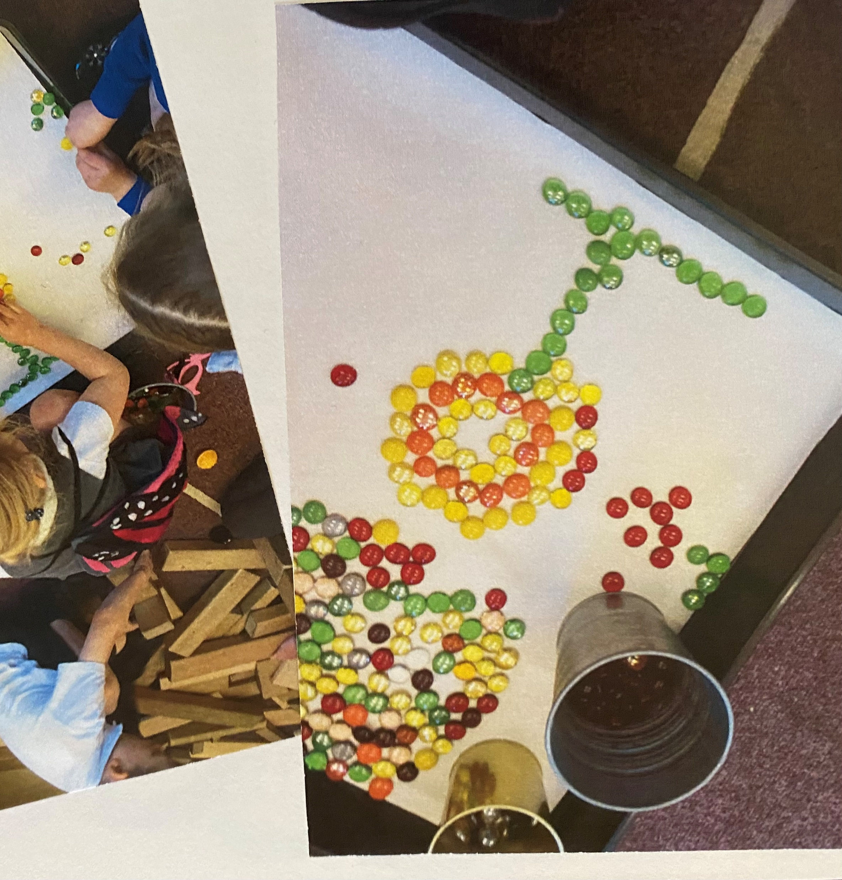
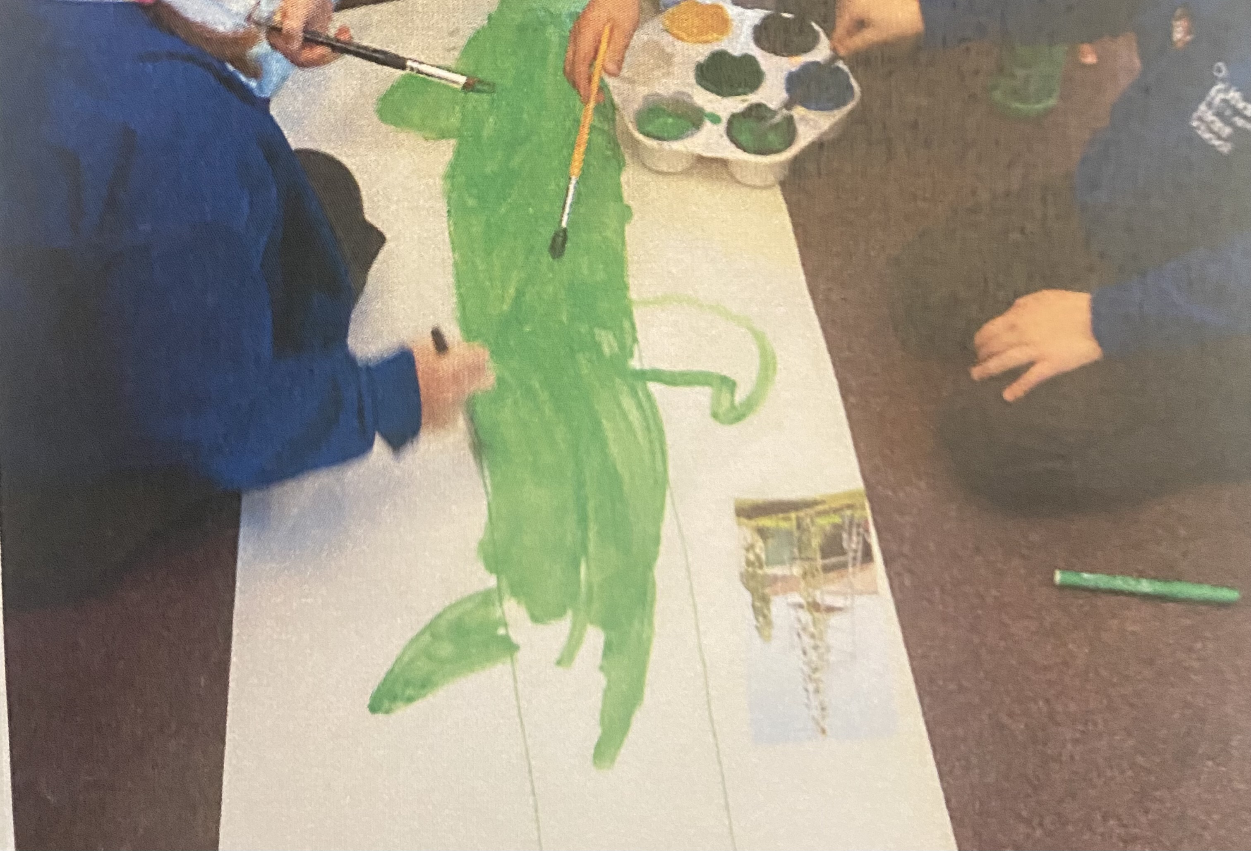
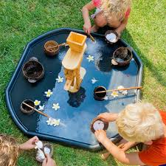
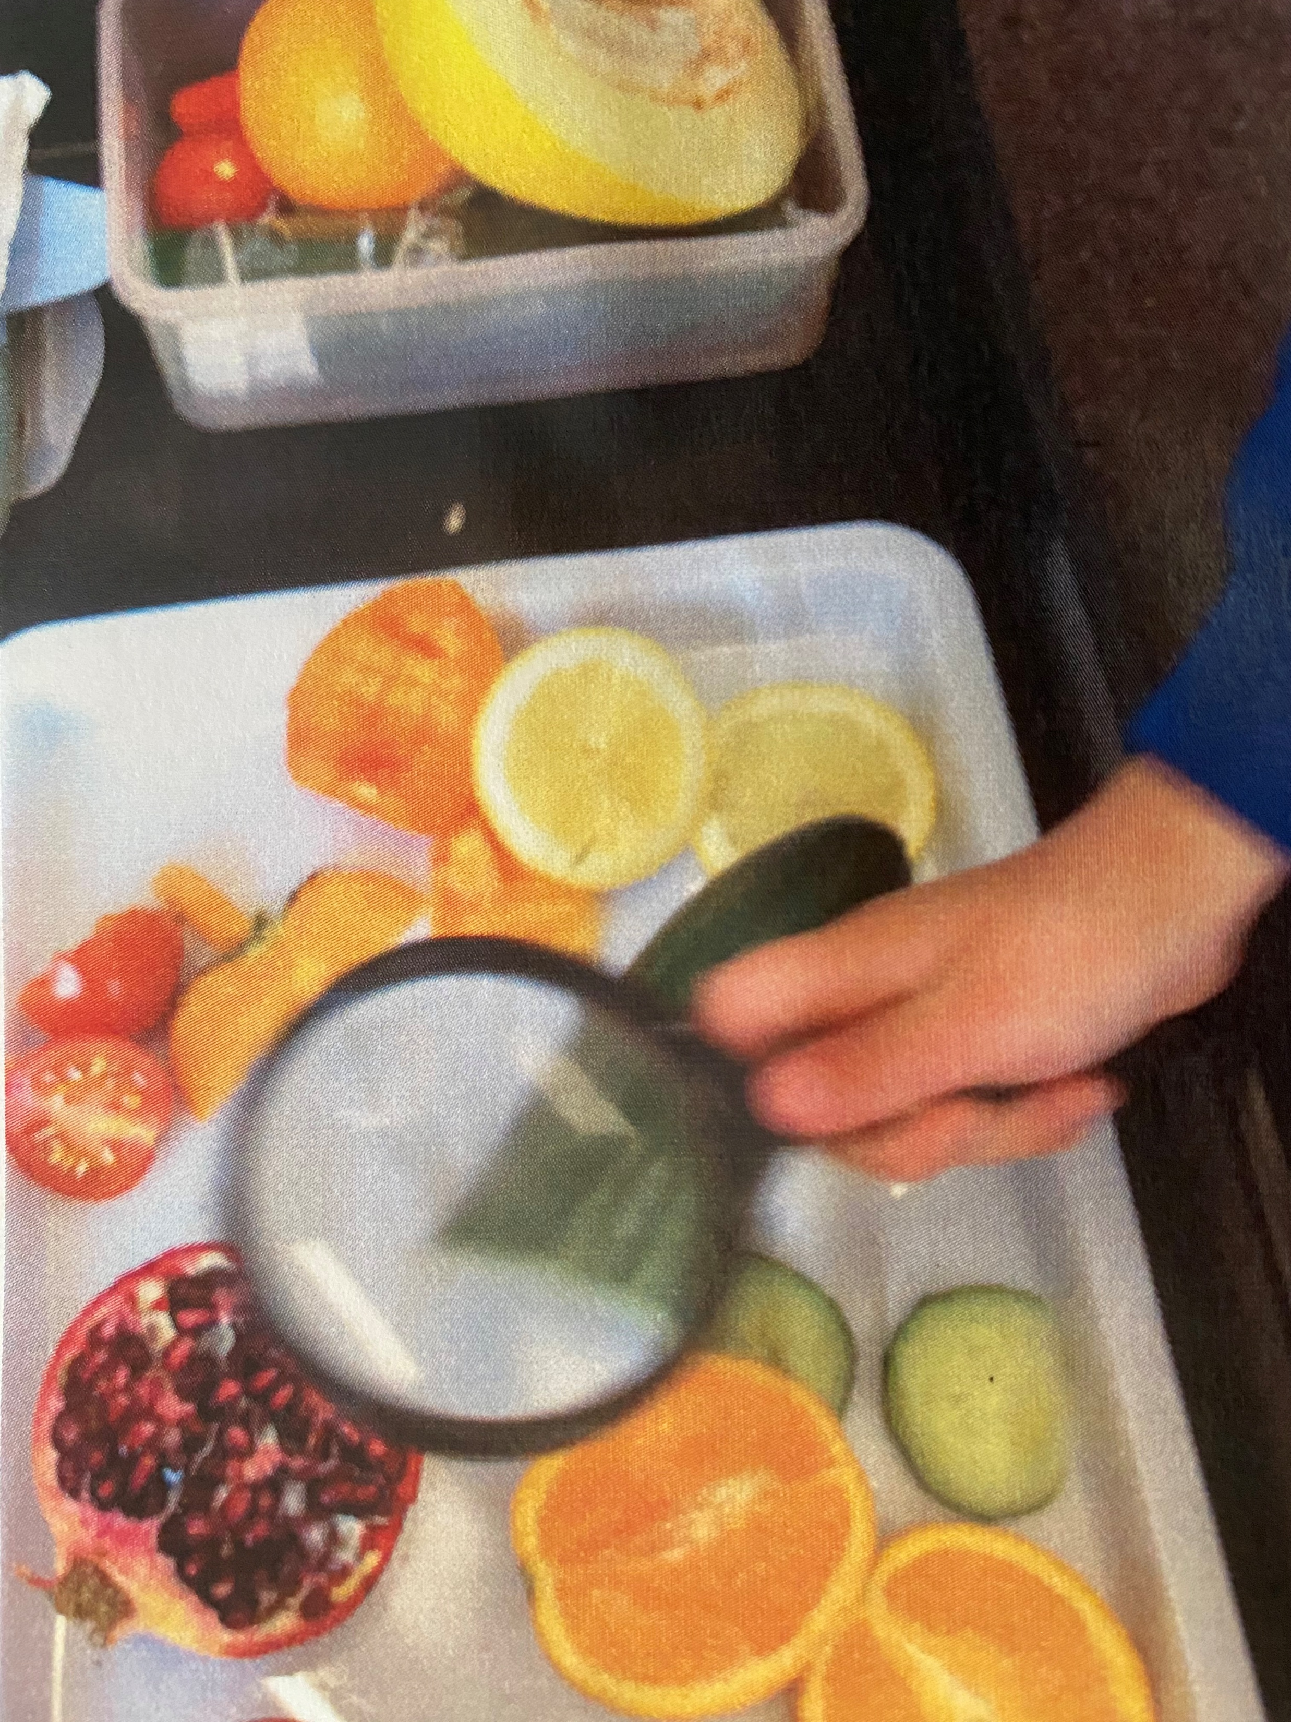
Timetable
Morning Activities e.g. fine motor
Register
Whole Class Input – Drawing Club/ English then groups
Continuous Provision (CP) Learning inside and outside – adults will either be joining/supporting/challenging children during their chosen play or leading adult-led activities
Enhanced Provision (EP) - related to the curriculum
Whole Class Phonics
Playtime
Maths Input – then groups
CP = Learning inside and outside
Enhanced Provision
Lunchtime – in the hall followed by playtime on the main playground.
Register
Handwriting – Kinetic Letters
Foundation Subjects/ CP EP
Collective Worship/ Story

Slide 4






Topics and Trips
It’s Good To Be Me
Celebration
Turrets and Tiaras
Roars, Paws and Claws
How Does Your Garden Grow.
I Do Like To Be Beside The Sea.
Trips….Victorian Day
Watch this space
Walk to the woods – Zebon Copse.

Slide 5

Homework
Reading - please keep zippy wallets and books in book bags.
Other homework will be sent out at times during the year.
Purposeful learning and experiences
Sharing together

Slide 6
Things to know!
Library day – Monday, new book every 2 weeks if book is returned.
PE day – Monday and Thursday
Things that come to school – Named water bottle, named healthy snack (optional), named book bag.
Coat
Label everything……..everyone has a blue jumper!
Please keep toys at home.

Slide 7
Time to celebrate
Good news including out of school activities
Shining stars
Class Assembly
Nativities
And many more including open classrooms
keep an eye on the newsletter for important dates

