Slide 1
Welcome to Year 2

Slide 2
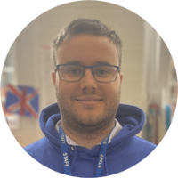
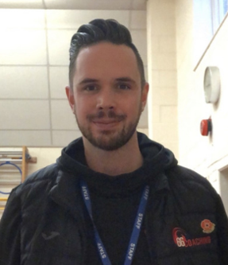
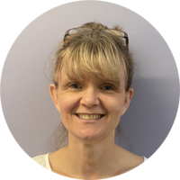
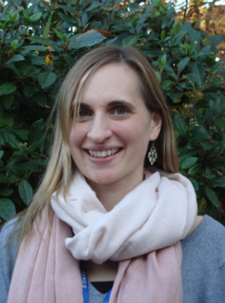
Pine Class
Mr Lewendon
Mrs Vinnicombe
Mrs Vickery (Fridays)
Mr Miles
Sports Coach
66Coaching
Lunchtime Supervisor

Slide 3

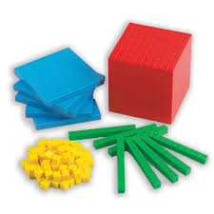

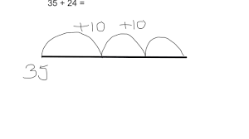

Timetable
Register
Phonics – Based on SoundWrite – Recalling a previous sound, looking at a new sound and applying the sound within either writing or reading.
Maths – Focus on a small objective that is scaffolded carefully throughout the lesson using a range of resources –using a CPA journey.
Playtime – Main playground
Handwriting Kinetic Letters
English – Based on a core text. Learning builds up with learning broken into small steps for several weeks and then brought together with a bigger piece of writing.
Lunchtime – in the hall followed by playtime on the main playground.

Slide 4
Timetable
Register
Guided Reading – Group and whole class sessions to develop reading and comprehension.
Foundation – PE is on a Monday and Wednesdays
Story
Collective Worship
Home Time
RE will be on a Thursday morning
Hampshire Music Lessons every Wednesday in Autumn and Spring

Slide 5
Topics and Trips
Nature and habitats
Dragons
Great Fire of London
Wolves
Rainforests
Flight and Space
Mary Seacole and nursing
Brazil
Flower Art
Van Gogh
Trips:
Basingbourne Park
Church
Summer Trip TBC

Slide 6

Homework
Homework through Google Classrooms set on a Friday. Copies of the worksheets are in the office, but instructions, spellings and links are only on Google Classrooms.
We collect homework on a Friday either through online submissions or paper. I will mark them and leave comments.

Slide 7

Reading
Please try and read with your children every day (5 times a week). Reading regularly out loud is so important at this age level, considering reading pace, moving into more sight reading and adding voices to the characters. Children who do not read at home regularly will struggle to be at an expected level by the end of the year. It only needs to be five-ten minutes a day.
I will collect in the reading books on a Thursday and send them out again on a Friday but please ensure books are in their bags everyday as we will also be listening to children read throughout the week.

Slide 8
Things to know!
PE day – Wednesday’s with Mr Miles and Monday with teachers.
Things that come to school – Named water bottle, named healthy snack, named book bag.
Label everything……..everyone has a blue jumper!
Please do not bring toys or fidgets in from home.

Slide 9
Time to celebrate
Good news including out of school activities
Shining stars
Nativities
Ultra Stars from class teacher
And many more including open classrooms
keep an eye on the newsletter for important dates

