Slide 1
Welcome to Year R

Slide 2
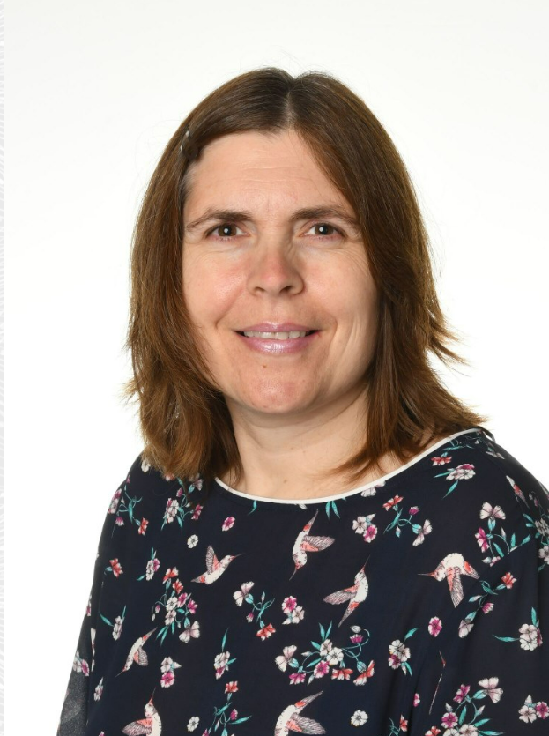
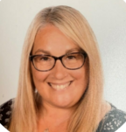
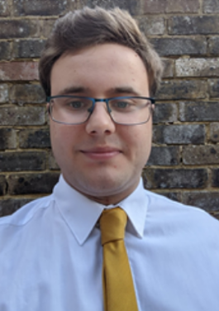
Ash Class
Mr Blake
Mrs Ashfield
Mrs Mamotte
Beech Class
Miss Gross
Mrs Thomas
Mrs Vickery
Mrs Clark and
Mrs Lidington Headteacher and SENDco
EYFS Lead Mr. Lewendon

Slide 3
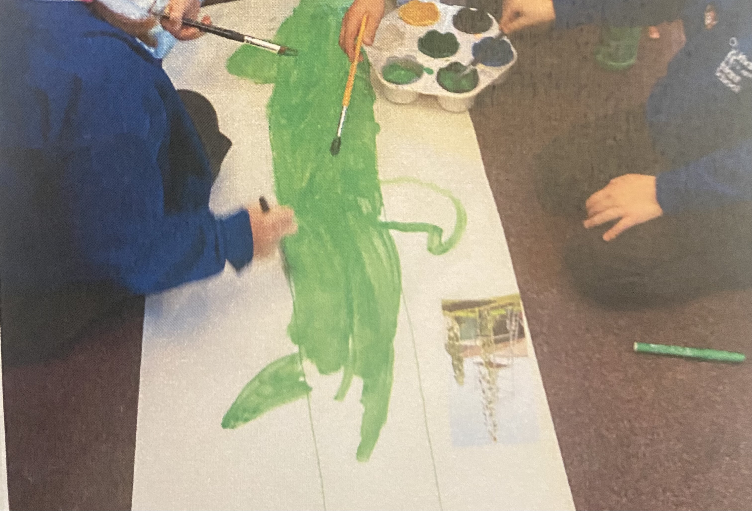
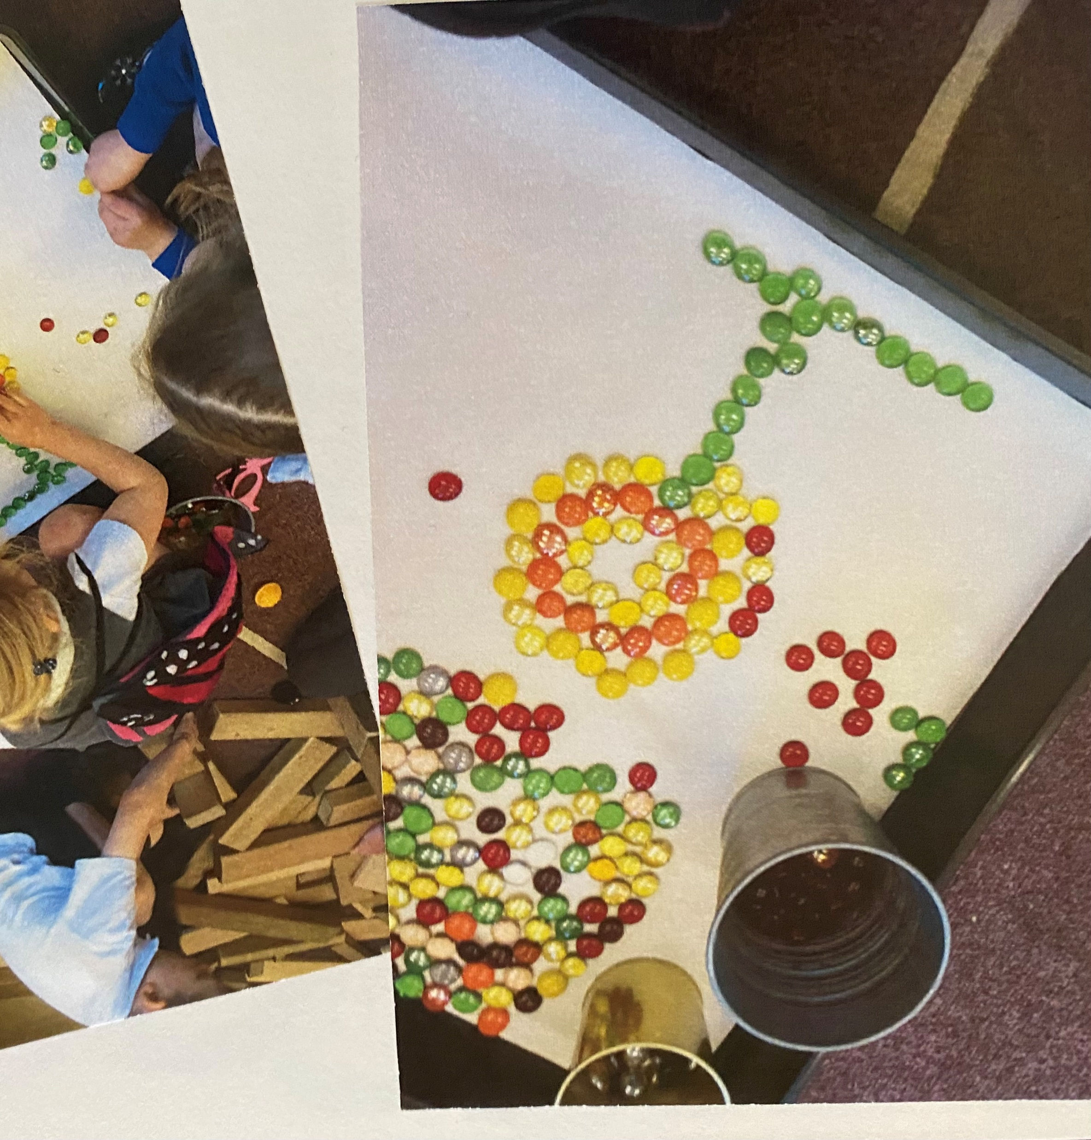
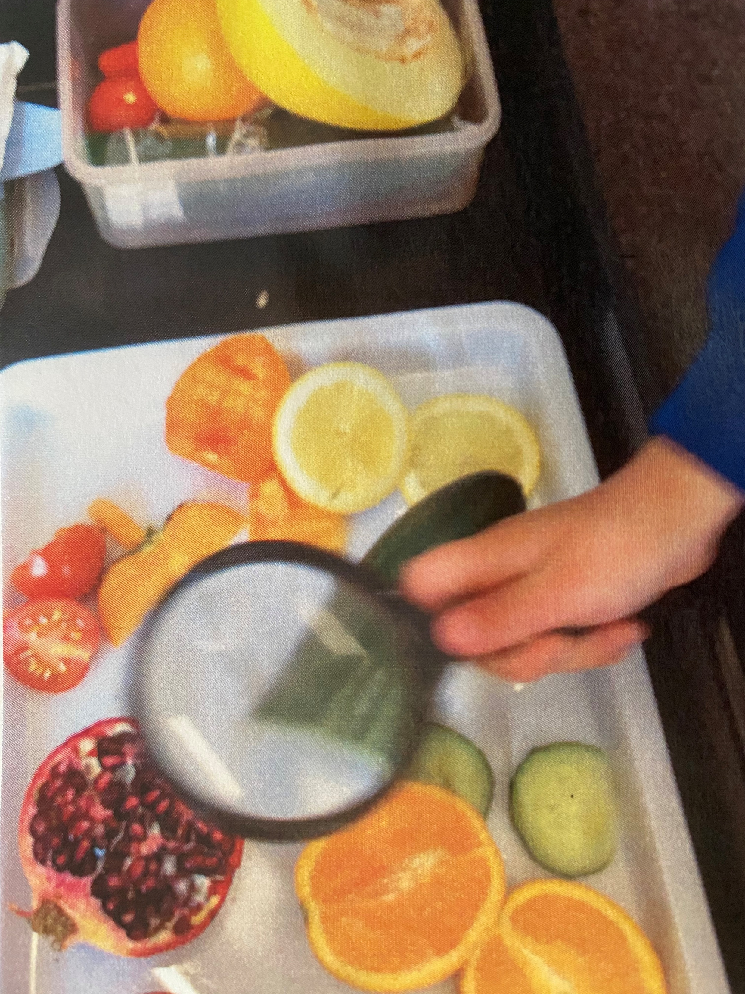
Timetable
Register
Whole Class Phonics
Playtime – Main playground and Year R only
Snack and Milk Time – inside
Whole Class Input – linked to an area of the Early Years Curriculum
Child Initiated Learning inside and outside – adults will either be joining/supporting/challenging children during their chosen play or leading adult-led activities
Child Initiated Learning inside and outside
Whole Class Maths
Lunchtime – in the hall followed by playtime on the main playground.

Slide 4
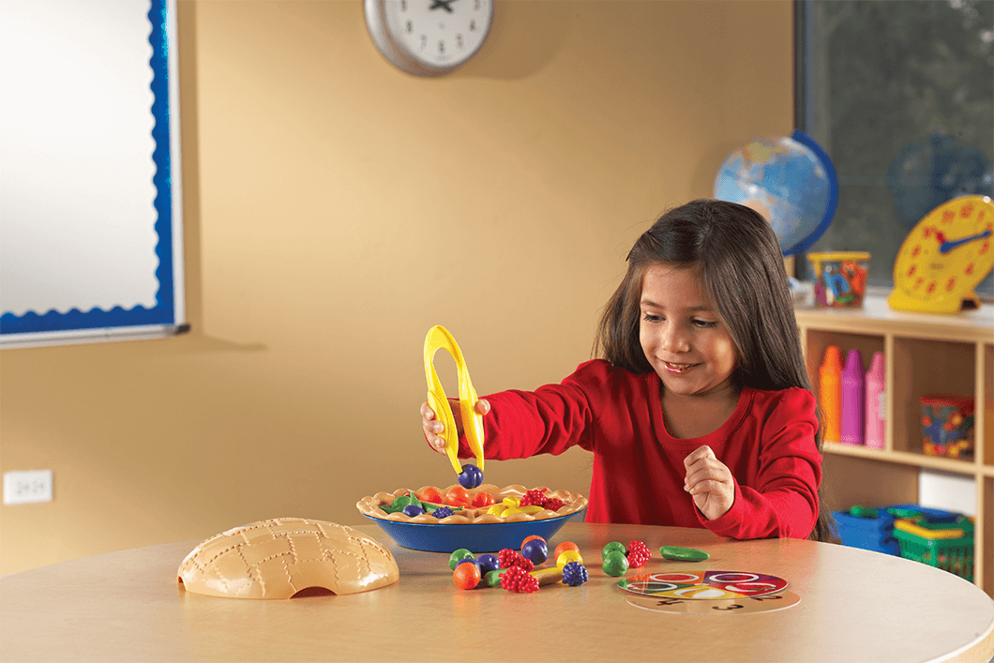

Timetable
Register
Noticing Talks – developing noticing skills and vocabulary.
Handwriting – Gross motor, fine Motor and Handwriting opportunities.
Child Initiated Learning inside and outside
Story + Movement of the week
Collective Worship
Home Time

Slide 5







Topics and Trips
Me!
Autumn
Space
Celebrations – Firework Night, Christmas
Different places around the world
Traditional tales
Sunflowers
The Ocean
Trips….Watch this space

Slide 6

Homework
Reading - books will be changed on a Friday.
Please ensure your child’s book and reading folder are brought into school every day.
If their reading book isn’t in their bag on a
Friday they will NOT be given a new one.

Slide 7
Things to know!
Library day – Monday, new book every week if book is returned.
PE day – Tuesday: Children should come in wearing their PE kit on a Tuesday after half term.
Things that come to school – Named water bottle, named healthy snack, named book bag, reading folder.
Label everything……..everyone has a blue jumper!

Slide 8
Time to celebrate
Good news including out of school activities
Shining stars
Class Cuddly toy
Class Assembly
Nativities
And many more including open classrooms
keep an eye on the newsletter for important dates

Slide 9
Behaviour policy
At this school we use a positive behaviour approach to supporting children to make good choices and follow the schools rules:
Kind Hands, Kind Words and Kind Feet
We understand that children will at times make mistakes with their behaviour; staff will positively unpick and discuss how to make our behaviour better now/ next time using conflict resolution.

