Slide 1

Welcome
Notes:
NOTE: To change images on this slide, select a picture and delete it. Then click the Insert Picture icon
in the placeholder to insert your own image.

Slide 2
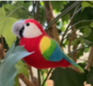
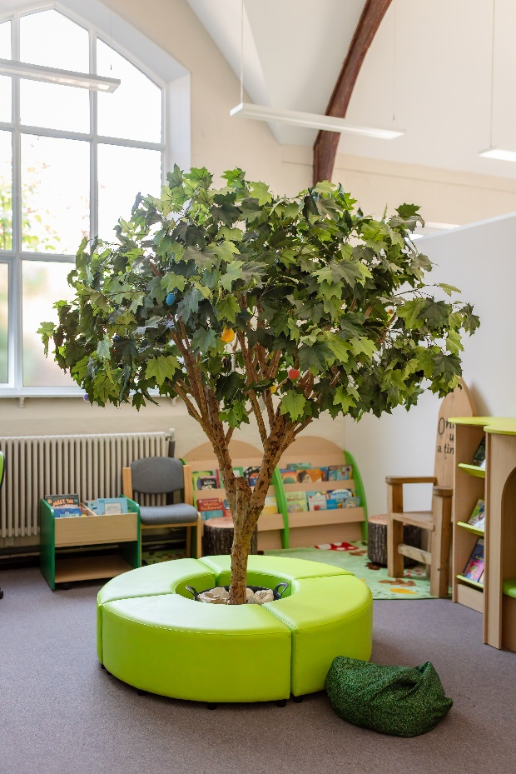
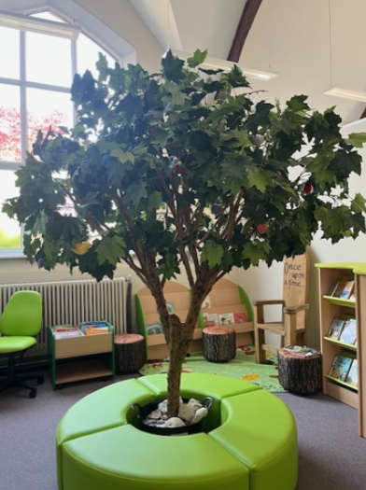
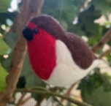
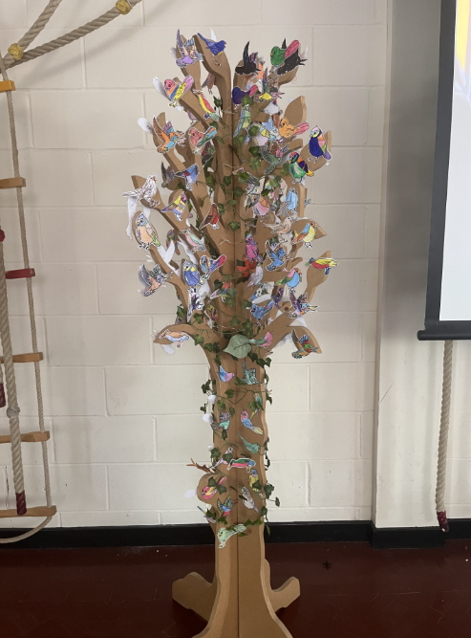
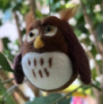
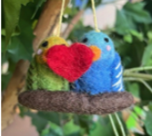
Our vision and values drive everything
we do.
From tiny seeds, we grow and learn together.
Little people can do big things through love, courage and joy.

Slide 3
From tiny seeds, we grow and learn together.
Our school vision is inspired by the parable of the mustard seed. When planted and nurtured by a loving community, every seed can grow and flourish.
Our school is like the mustard tree; a place where all are valued and belong.
Our children are like tiny seeds; in good soil they can grow as loving, courageous and joyful individuals, ready to branch out and be good news in an ever-changing world.
Our team of gardeners enable each unique child to flourish, removing barriers, and supporting growth.
Little people can do big things through love, courage and joy.
Jesus told them a parable: “The Kingdom of Heaven is like a tiny mustard seed planted in a field. It is the smallest of all seeds but becomes the largest of plants, and grows into a tree where birds can come and find shelter.”

Slide 4
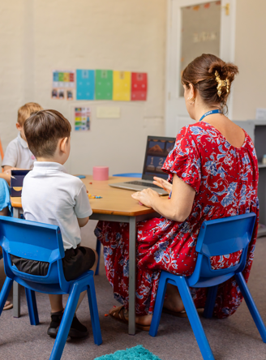
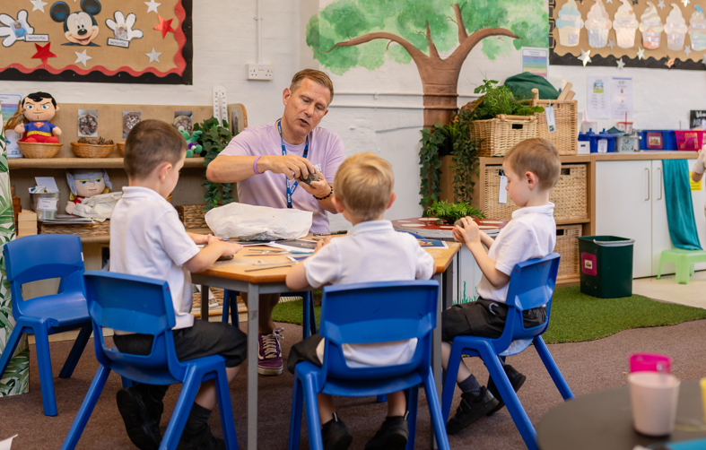
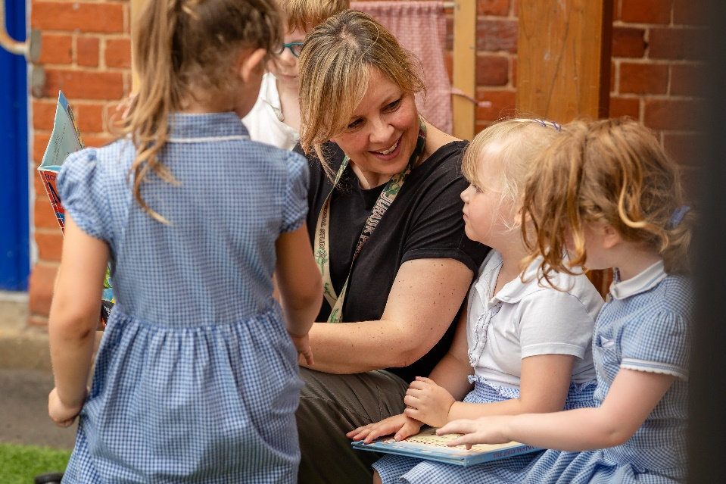
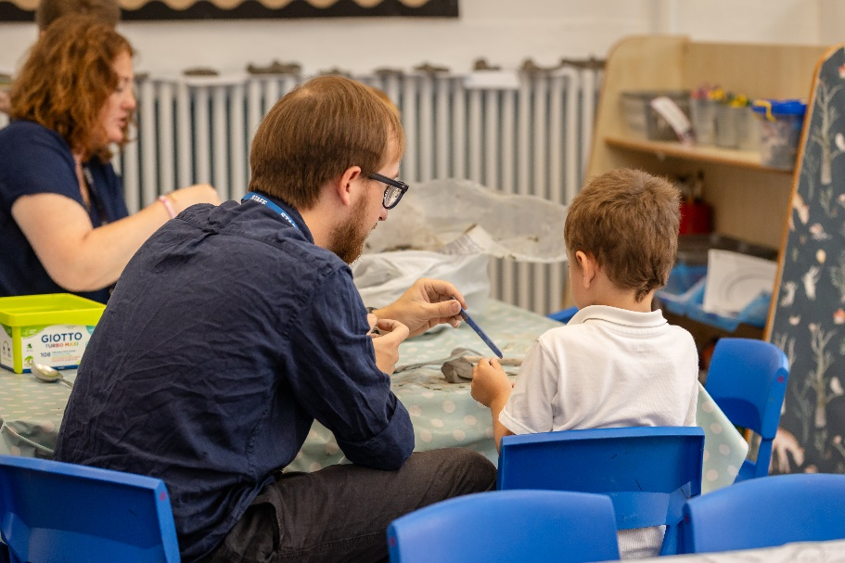
Meet the Team

Slide 5

Behaviour principles
learning
Habits & animals
Recognition & celebration
Kind Words, Kind Hands, Kind Feet
Good News
Shining Stars
Headteacher Tea Parties

Slide 6
Behaviour principles
Kind words, kind hands, kind feet
Appreciating our beautiful world with awe and wonder.
Knowing that we are loved as unique individuals.
Celebrating our differences and what makes others unique.
Treating others with kindness.
Developing strong learning habits and a life long love of learning.

Slide 7




learning
Habits & animals
“Pupils are supported well to develop beyond their academic learning……The school have designed an ambitious and thoughtful curriculum.”

Slide 8
Behaviour principles
learning
Habits & animals
Recognition & celebration
Kind Words, Kind Hands, Kind Feet
Good News
Lunchtime Good News
Shining Stars
Headteacher Tea Parties

Slide 9
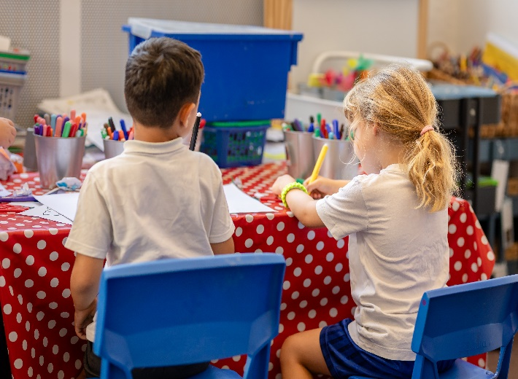
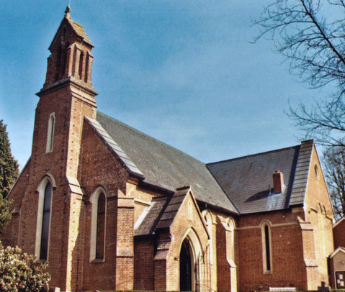
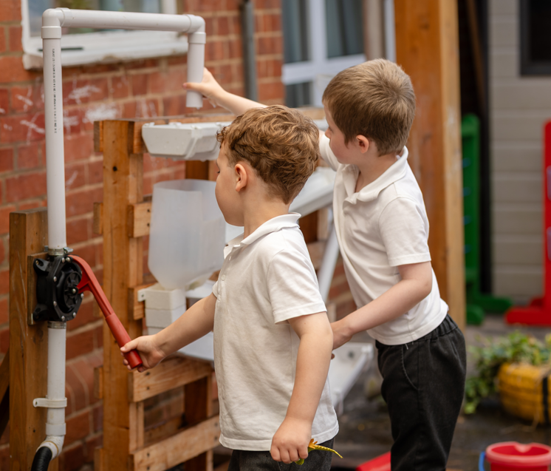
AN INFANT
SCHOOL
A CHURCH
SCHOOL
A LOVING COMMUNITY

Slide 10
AN INFANT
SCHOOL
A CHURCH
SCHOOL
A LOVING COMMUNITY
Play and joy!
Active Learning
Early Reading & Number skills
Sense of self
Oracy

Slide 11
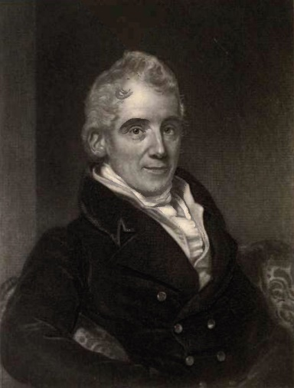
AN INFANT
SCHOOL
A CHURCH
SCHOOL
A LOVING COMMUNITY
Flourishing for all
Vision: Deeply Christian, serving the common good
Collective Worship; Spirituality; RE
Church & School partnership

Slide 12
AN INFANT
SCHOOL
A CHURCH
SCHOOL
A LOVING COMMUNITY
Strong relationships as the foundation
Governors
FOCIS
Care Club
Parent Partnership
Wider Community

Slide 13
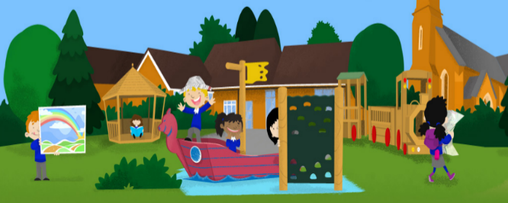
Early Years
Year R consists of a balance between adult-directed and child-initiated play, both indoors and outdoors, as well as free flow.
Children will spend a large proportion of their day experimenting with and applying their learning through play.
There will be a number of short carpet inputs throughout the day such as Phonics, Maths or Story Time.
Adults will immerse themselves in children's play in order to skilfully facilitate children applying new skills in a way which interests and engages them, as well as working with small groups on planned activities.

Slide 14
Teaching Across the School
Year R follows the EYFS Curriculum, similar to the children's nursery or pre-school they are currently attending. We also use a variety of topics across the year to support the children’s interest in learning.
During the first half term of the academic year, the focus is on personal and social skills as well as fine and gross motor skills.
Key Stage 1 (Year 1 and Year 2) children at Crookham CE (A) Infant School access the National Curriculum. This includes subjects such as Music, Drama, PE, DT, Science, History, RE, Art and Geography as well as English and Maths.

Slide 15






High quality, carefully selected curriculum choices:

Slide 16
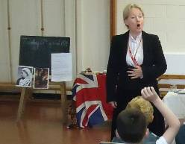
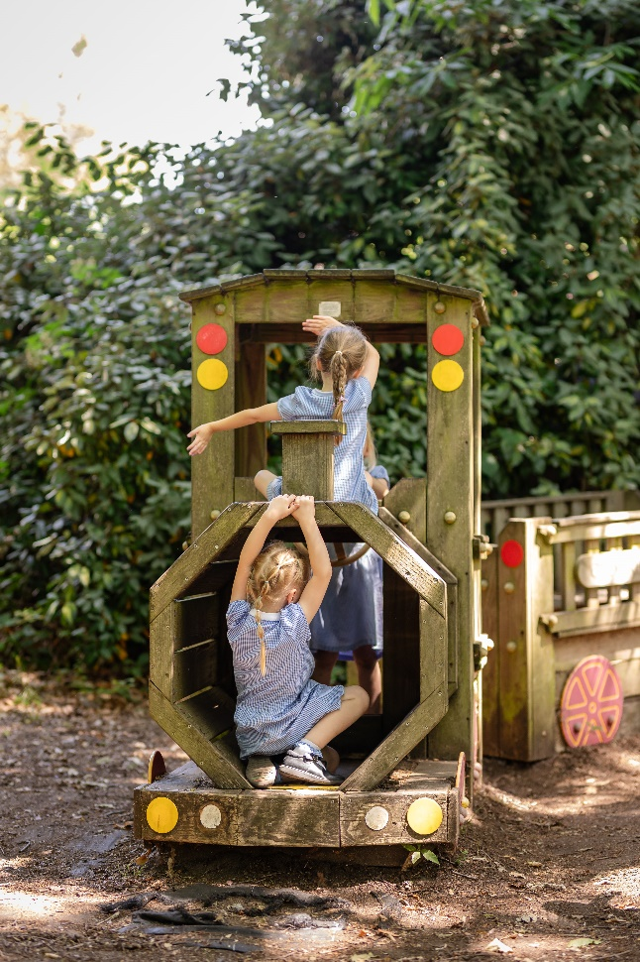

Curriculum Enrichment
Clubs
Visits
Ocean Stars

Slide 17
Transition Arrangements
You will find out your child’s school in April 2027.
Initial contact will be made during that week to welcome you and your child to our school.
Contact will be made with all nursery/pre school settings to meet your child’s key worker, this may be in the form of a telephone call or a visit in person to the setting.
We provide class visits with one parent prior to the Summer holidays.
At the beginning of September home visits are led by the Year R team.
The children then attend school for one morning, and then the next day, a morning session including lunch.
Following this, all children in Year R are full time.

Slide 18
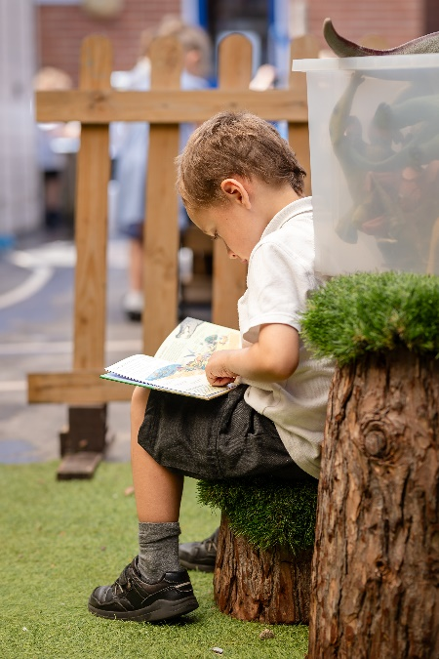
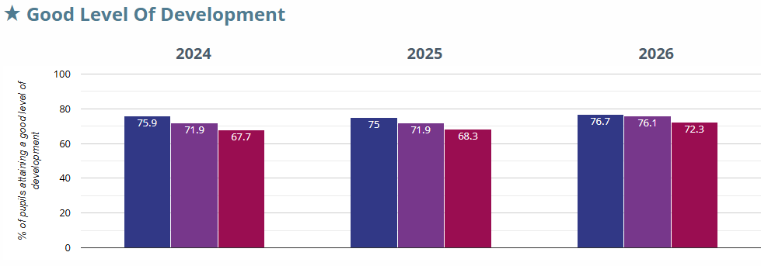
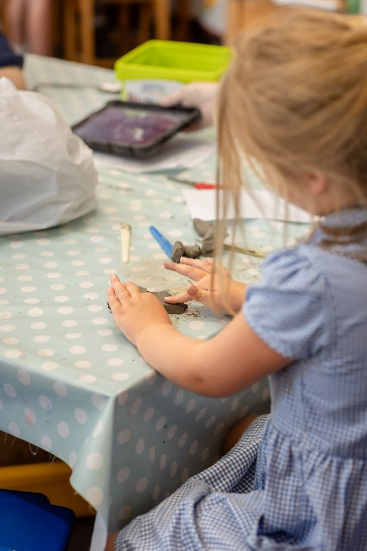
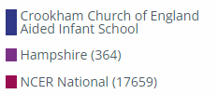
“Children get off to a flying start in Early Years”

Slide 19
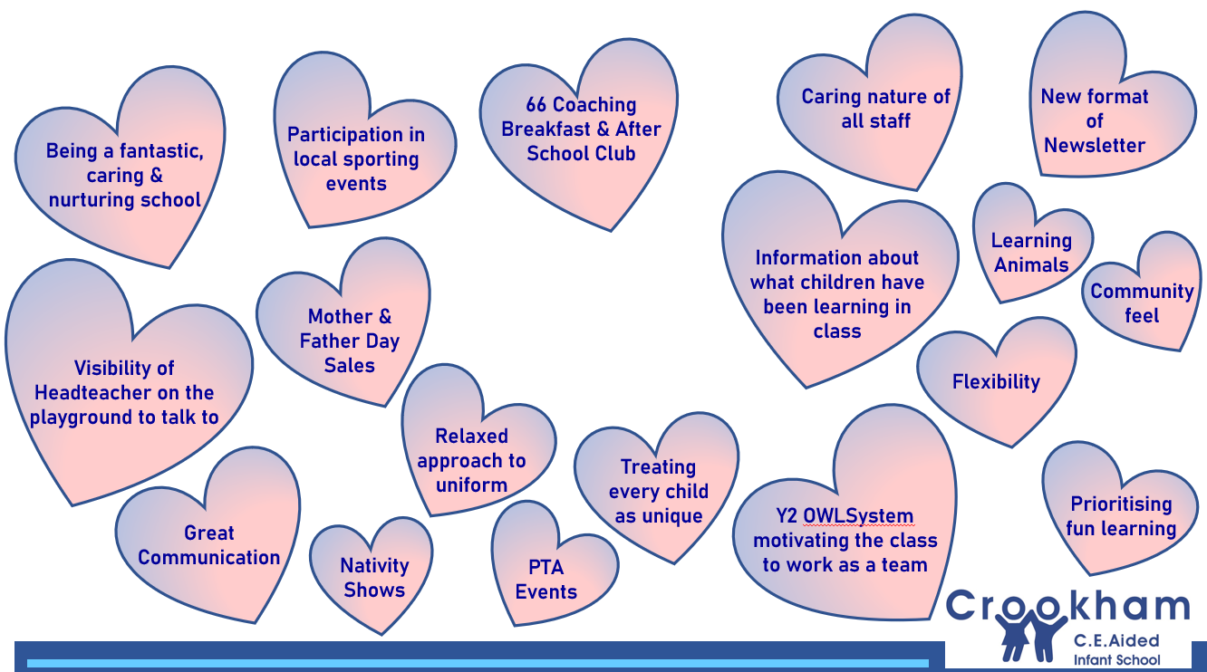
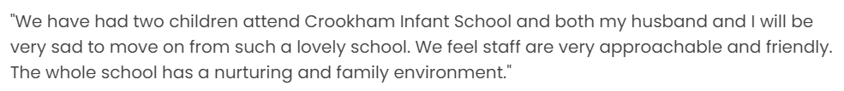
What do our parents love about our school?

Slide 20
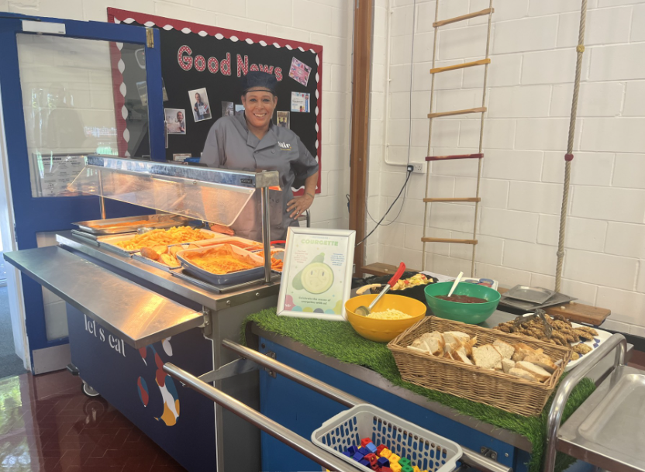

Universal Free School Meals

Slide 21




Slide 22



Support for Our School

Slide 23
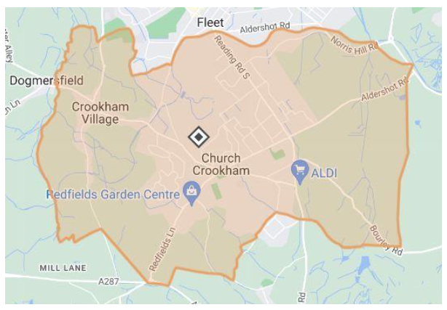
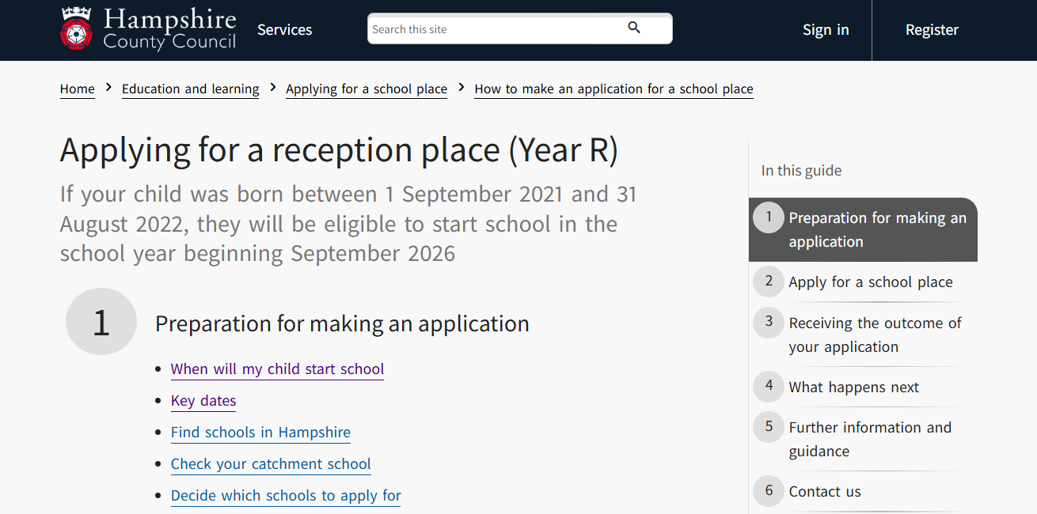
Applications & Admissions

Slide 24
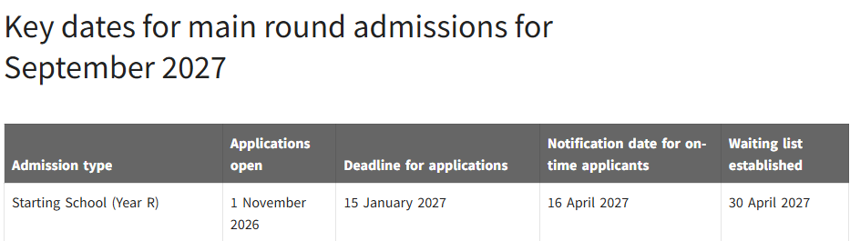
Applications & Admissions

Slide 25
Thank you
Questions
Notes:
NOTE: To change images on this slide, select a picture and delete it. Then click the Insert Picture icon
in the placeholder to insert your own image.

